Slide 1
Work Culture and Behavior
The Impact on Medication Errors
Melissa Robinett, RN, BSN

Slide 2
Case Study
Notes:
Furosemide given triple the dose.
Guess who? Betty again.
This is her second medication error in two weeks.
I don’t think she is going to work out

Slide 3
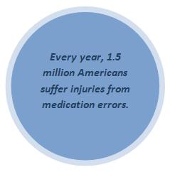
Statistics
The Institute of Medicine (2008)

Slide 4
Statistics
It is estimated that there are 800,000
Medication Errors in nursing homes annually
Annuals of Long Term Care (2008)

Slide 5
Most Common Type of Error - Study
Totals
25 LTC Facilities – 23 reported (1 year)
631 errors reported with total being 2731 (repeated errors)
48% occurred during administration
Cecil Sheps: Center for Health Services Research University of North Carolina at Chapel Hill
Notes:
Study done by Cecil G Sheps Center for Health Services Research, University of North Carolina at Chapel Hill.
Study of 25 LTC facilities – 23 reported.
North Carolina
631 error report Frequency of the error 2731 (Repeated error)
Most Common Type of Error:
Omission (203 – 32%)
Overdose –(91 – 14%)
Under dose (43 – 7%)
Wrong Patient (38 – 6%)
Wrong Product (38 - 6%)
Wrong Strength (38 - 6%)
48 % occurred during administration
48% were attributed to basic human error
According to American Nurse Today administration errors account for 26-32% of all medication errors

Slide 6
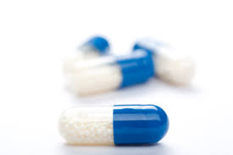
Most Common Medications - Study
Lorazepam
Oxycodone
Hydrocodone
Warfarin
Furosemide
Insulin
Fentanyl
Notes:
In the same study:
Seven Medications were implicated in a third of all of the errors:
Lorazepam
Oxycodone
Warfarin
Furosemide
Hydrocodone
Insulin
Fentanyl
Other studies have shown that the four classes of medication that send patients back to the hospital when an adverse event occurs are:
Opioids
Hypoglycemic
Anticoagulants
Anticancer agents

Slide 7
Rule Based Society
Notes:
Where we come from: Rule Based.
Procedural violations are simply unacceptable.

Slide 8
Current Model
1
2
3
4
Work Quickly and Accurately
Counsel Educate
Discipline Dependent on Severity
Don’t Break The Rules
Notes:
We ask staff to
work quickly, carefully.
When something bad happens we counsel, educate
The severity of discipline determined is determined by the outcome.

Slide 9
Rule Based Society
Notes:
Where we come from: Rule Based.
Dudley More Once said “ The best car safety device is a rearview mirror with a cop in it.

Slide 10
Good Rules – People Will Follow
"This enforcement action demonstrates we are serious about our safety action plan which stresses improved safety through stronger enforcement and tougher penalties," "Those who disregard truck safety regulations and endanger the traveling public will feel the full force of federal response."
Federal Highway Administrator Kenneth R. Wykle
Notes:
Rule Based: All we need is really good rules and people will stay safe.
When rules are not followed, we will punish.
This makes us “feel better”.
This statement in regards to reducing deaths and traffic crashes related to the length of truckers hours.

Slide 11
Blame Free Environment
The single greatest
impediment to error
prevention in the medical
industry is “that we
punish people for making
mistakes.”
Dr. Lucian Leape Testimony before Congress on Health Care Quality Improvement
Notes:
In 2001 we swung to the other side: To Human is to ERR.
Blame free culture, which did not deal with reckless behavior
Dr. Lucian was a member of the Institute of Medicine’s Quality of Care in America Committee, which published “To Err is Human” in 1999 and “Crossing the Quality Chasm” in 2001.

Slide 12
The Sweet Spot
Punitive
Blame Free
Notes:
Somewhere in between the blame free and punitive culture is where we get the best outcome.

Slide 13
Where We Want to Be
Good Systems
Good Behavioral Choices
Good Results
Notes:
Majority of Errors are System and Processes
Increase patient care if we target system and processes not people

Slide 14
Where We Are Headed
Shared Accountability
Transparency
Staff is thoughtful and aware of Behavioral Choices
Leadership looking at process and system design
Accountability is not dependent on the outcome, but more on the choices made by the employee.
Staff Continually Looking for Risk
Punitive
Notes:
Somewhere in between the blame free and punitive culture is where we get the best outcome. Where we are going:
Emphasis on learned and shared accountability
Employees continually look for risk
Employees are thoughtful about behavior choices.
Managers looking for system design that is reliable
Majority of Errors are System and Processes
Increase patient care if we target system and processes not people

Slide 15
Start at the Beginning
New Hire Messaging
Job Descriptions
Notes:
Starts at the beginning with messaging
Messaging of safety should also be in job descriptions

Slide 16
What does a Safety Culture Look Like
PERFORMANCE
PROCESS
DISCIPLINE
PATIENT
SAFETY
PROFESSIONALISM
Notes:
Known top priority from leadership to prevent harm and safety is first
Short “script” version:
Operational excellence … how we deliver on our customer promise
Patient Safety … our # 1 priority. We partner with our customers to eliminate process variation or weaknesses that threaten patient safety.
Process Discipline … our work is defined, standardized, and tuned to prevent defects. What works today is not good enough for tomorrow, so we are committed to managed, aggressive improvement.
Professionalism … Success depends on hiring, training, and supporting a skilled workforce. People make our business go. We find the best, and expect their best.
Performance … We measure our performance, and use that data to drive improvement.

Slide 17
How to Get Started
Incident Reports:
Should be welcome
Valued as a learning opportunity
Should be easy to fill out and readily available
Notes:
Incident reports are welcomed and valued as learning opportunities
Teamwork attitude
Staff comfortable drawing attention to possible safety concerns
Think about SBAR? The narrative is very important.

Slide 18
SBAR

Slide 19
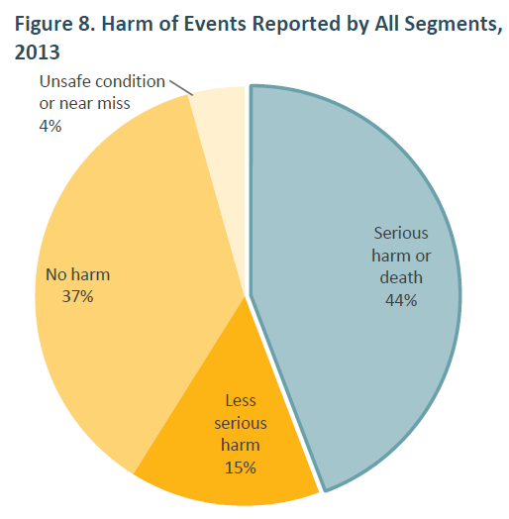
Oregon
2013 Oregon Patient Safety Commission Annual Summary
Notes:
What stands out on this slide.
We are going to learn just as much from near misses as we would from serious events.

Slide 20
How to Get Started
Transparency:
Move from secrecy to transparency.
Comfort in bring attention to potential safety concerns.
Leadership:
Top Priority
Agenda items in meetings
Present learning sessions and brainstorm on ways to improve
Notes:
Transparency:
Move from secrecy to transparency.
Comfort in bring attention to potential safety concerns.
Leadership:
Top Priority
Agenda items in meetings
Present learning sessions and brainstorm on ways to improve

Slide 21
Benefits of Changing to a Safety Culture
1
Happy Health Work Environment
2
Decrease Staff Turn Over
3
Decrease New Hire Costs
4
Employees Support Organization
Notes:
Staff Retention
If the employee feels supported, they will support the organization
Happy Healthy Work place
Decrease resignations
Decrease cost for hiring new employees

Slide 22
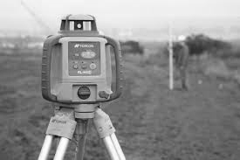
How to Get Started
Survey your staff to get current perception of safety culture
Expect discrepancies between leadership and staff
Identify trends or any areas that need to be addressed
Notes:
Survey: Staff and Leadership perceptions will differ
Identify: Trends or areas needing to be addressed

Slide 23
How to Get Started
Implement changes ensuring that staff is communicated to.
Also helpful to get staff involvement.
Revise policies and processes
Communicate to staff the goal and vision of the changes
Train and educate staff on new policies and processes including clear expectations
Notes:
Implement: Make sure staff is communicated to regarding the changes that will occur. Also helpful to get their involvement
Revisions: P and P revisions should include staff input
Train: Staff on P and P’s and share the goal and vision (make expectations clear)

Slide 24
How to Get Started
Encourage Question
Commit to understanding why medication errors happen. Looking at systems before a person.
Notes:
Train: Staff on P and P’s and share the goal and vision
Encourage: Questions
Commit: Leadership needs to commit to understanding why medication errors happen and look at systems

Slide 25
Risk Management
1
Humans Will Make Mistakes
2
To Drift is Human
3
Risk is Everywhere

Slide 26
Concept 1 –Humans Will Make Mistakes
Notes:
First Concept:
We spend 75-85% of our time in automatic absent mindedness
Systems need to be full proof.
To Err is Human
No one is immune
The best way to manage human error is to make your systems as immune to human error as possible.

Slide 27
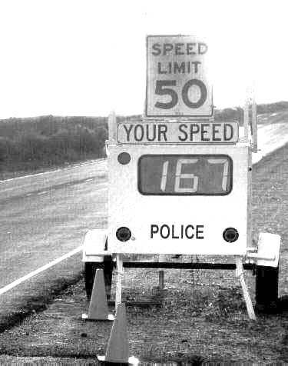
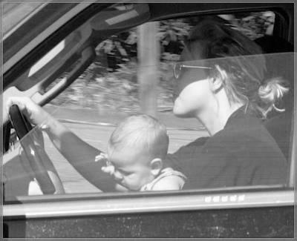
Concept 2 -To Drift is Human
Notes:
Concept 2: To Drift is Human (At Risk Behaviors) – Most Common
Main reasons to drift is: Accomplish more and fading perception of risk.
At risk behavior is a behavior choice:
Convince ourselves it is safe
Unknowingly create unjustified risk.

Slide 28
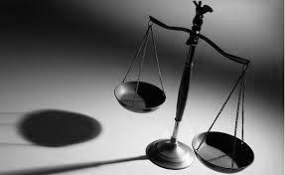
Concept 3 - Risk is Everywhere
Notes:
Third Concept: risk is everywhere
Healthcare can be safe, but not risk free
We weigh Risk/Benefit Daily
Example: A child needing a life saving surgery, but it is a new procedure.
Medications that all have risk, but the benefit outweighs the risk.

Slide 29
Behavior Types
Human Error
At-Risk Behavior
Reckless Behavior
Slip
Lapse
Mistake
Behavioral Choice
Risk out Weighs Benefit
Conscious Behavior
Unjustifiable Risk
Console
Learn
Coach
Learn
Punish
Learn
Notes:
Human Error: Forgot to do something in the process
At Risk: Chose to not do something because the risk was not “real” or perceived
Reckless: Chose not to do something with conscious disregard. (reusing a needle on another resident)
Behaviors can move from at risk to reckless (texting, DUI)

Slide 30
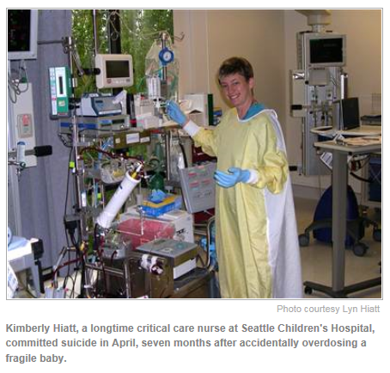
Second Victim
Notes:
Kimberly Hiatt a Critical Care Nurse at Seattles Childrens Hospital.

Slide 31
5 Rights of Second Victim
T
Treatment -They did not intestinally harm
R
Respect – Don’t Blame
U
Understanding and Compassion - help grieve
S
Supportive Care
T
Transparency Opportunity to Contribute
Too many abandon the "second victims" of medical errors
From the July 14, 2011 issue
Notes:
Five rights of second victims. Charles Denham, chairman of TMIT, proposes five human rights for second victims, (2) which can be remembered by the acronym TRUST:
Treatment that is just: second victims deserve the right of a presumption that their intentions were good, and they should be able to depend on organizational leaders for integrity, fairness, just treatment, and shared accountability for outcomes
Respect: second victims deserve respect and common decency and should not be blamed and shamed for human fallibility
Understanding and compassion: second victims need compassionate help to grieve and heal, and leaders must understand the psychological emergency that occurs when a patient is unintentionally harmed
Supportive care: second victims are entitled to psychological and support services that are delivered in a professional and organized way
Transparency and opportunity to contribute: second victims have a right to participate in the learning gathered from the error to share important causal information with the organization and to provide the victims with an opportunity to heal by contributing to the prevention of future events.

Slide 32
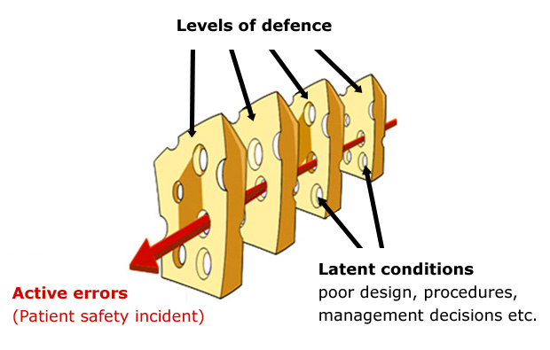
Active vs. Latent Failure
Notes:
Active Failure: A person and system error. Example a person pushing the wrong button on the machine that causes an error.
Latent Conditions: Systems.

Slide 33
Who Do We Want on Our Team
Do we punish good behavior or reward at risk behavior
Notes:
Examples:
Person who checks order more efficiently vs the person who just gets it done?
Nurse wants a double check on an order

Slide 34
What information are we going to gather and how?
Notes:
Case Study – Knowing what we know now. What information do you want to gather

Slide 35
Case Study - All the Facts
1
Medication Error / Mr. Jones in the Hospital
2
Resident does not use house pharmacy
3
Nurse added barcode to eMAR so med would scan
4
Medication Aide was interrupted to give PRN pain medication
5
Medication was in a bottle
6
Direction Change Sticker place over the dose on the bottle

Slide 36
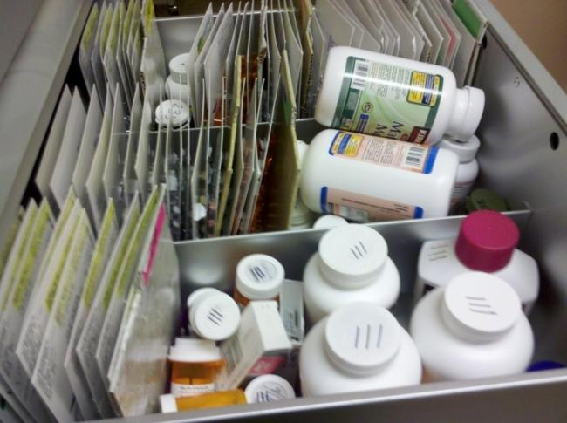
Going to the Gemba
Notes:
Medication Storage and Standardization
Medication Carts should be organized by facility standard not personal preference
Single Source pharmacy decreases medication error frequency
No stashing medications
Get rid of DC’d order
Change in direction orders
Change in direction stickers

Slide 37
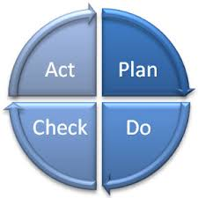
How do we Improve?
How can we improve?

Slide 38
Case Study - All the Facts
1
Console Betty
2
Process Improvement – Single Source Pharmacy
3
Policy – Never add barcode to eMAR system
4
Policy – Write request on paper
(Don’t Interrupt)
5
Policy – Bubble Pack when possible
6
Policy – Direction Change Stickers should not cover information

Slide 39
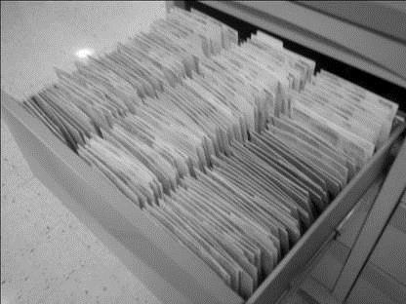
System Improvement
Notes:
Medication Storage and Standardization
Medication Carts should be organized by facility standard not personal preference
Single Source pharmacy decreases medication error frequency
No stashing medications
Get rid of DC’d order
Change in direction orders
Change in direction stickers

Slide 40
How Good is Your Medication System
Better than yesterday, but not as good as tomorrow

Slide 41
Learning More

Slide 42
Start the Movement

Slide 43
Questions

Slide 44
Reference Page
ISMP – www.ismp.com
Pamela Anderson, MS, RN, APN-BC, CCRN and Terri Townsend, MA, RN, CCRN, BC, CVN-II. Medication Errors: Don’t let them happen to you, www.AmericanNurseToday.com; March 2010
Richard G Stefanacci, DO, GH, MBA, AGSF, CMD; “Preventing Medication Errors” Annuals of Long Term Care (2008),
“Preventing Medication Errors” The Institute of Medicine (2008)
Vivian B. Miller BA CPHQ LHRM CPHRM FASHRM, Terry L. Jones, RN, PhD. Creating a Just Culture: A Nurse Leader’s Guide Danvers 2011

